Slide 1
PROFESSIONAL 3.0 Area development

Slide 2
PRESENTATION
Hanze University of Applied Sciences
Expert Centre NoorderRuimte
Do it Yourself in Rural Area
And in Urban Area?
Area Developer 3.0
Educational programs

Slide 3
WELCOME
JANNIE ROZEMA
Psychology
Lecturer
Researcher

Slide 4
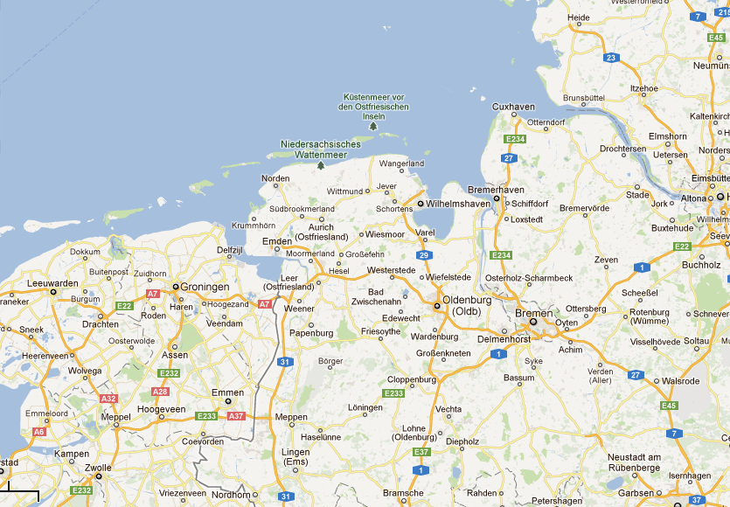
GRONINGEN - BREMEN

Slide 5
HANZE UNIVERSITY
Groningen, The Netherlands
Hochschule or:
University of Applied Sciences
19 schools with 25.000 students
6 Expert centres – applied research
Hanze themes: Healthy Ageing, Energy

Slide 6
EXPERT CENTRE
NoorderRuimte → the North of the Netherlands
Schools of
Architecture, Built Environment & Civil Engineering
Human Technology
Real Estate
Facility Management

Slide 7
THEMES
Climate responsive coastal defense
Marine Wetlands
Sustainable building & living
Living environment

Slide 8
LIVING ENVIRONMENT
PEOPLE
PLACE
PROCESS

Slide 9
RESEARCH PROGRAMME
Demographic changes & consequences
Independent living for aging population
→Livable villages
Professionals in area development
Housing associations
Municipality / County / Civil Service

Slide 10
RURAL AREAS NL
Small villages less than 400 inhabitants
Ageing and depopulation
Housing market
New comers: distant (digital) working
Budget cuts on community services
→ Villages think forward : 3.0 ☺

Slide 11
VILLAGES = DIY

Slide 12
INVOLVED ORGANISATIONS
Village organisation +++
Municipality ++
Housing association +
(Home) care giver & organisation
Education (especially primary school)
(Small) business & retail enterprise
Transport company

Slide 13
Hanze VILLAGE RESEARCH

Slide 14
APPRAISALS ON
Environment & housing
Social climate & networks
Services & entrepreneurs
Power & talents

Slide 15
VILLAGE DNA
Pull factors to stay or attract newcomers
Social cohesion
New entrepreneurship
Organizational power
OUTCOME
SWOT
Vision
Agenda
IDENTITY

Slide 16
CONCLUSION
60 - 80% wants to stay into old age
Good relations with neighbours secure (light) care
Mobility on well maintained roads & paths
New potential entrepreneurship on services, energy, tourism
60% wants to be active on village interests

Slide 17
MEANING OF PLACE (1)
“If people are attached to places, they want to invest time, energy and money and work together to make (their) place better”

Slide 18
URBAN AREA NL
Growth and attractiveness of cities
Renewal projects in postwar areas
Houses of the yrs 50 – 70
Property of housing associations
Monotonous & standard layout
Socio-economic problems
→ Professionals think forward: 3.0

Slide 19
INVOLVED PROFESSIONAL
Area coordinators, area managers of area developers
At housing association & municipality
Managing
Monitoring
Renewing
real estate, (home) economics, (landscape) architecture, social work, technics, civil service, teaching

Slide 20
DO IT..(new, different?)
on Area Development
From Physical | to | Integral
Planning Sectoral thinking Technical Standards Product oriented New build | → | Planning & Communication Coproduction Socio-physical-econ-organizational Diversity People oriented Re-use
Notes:
Aanleiding: beweging van fysieke naar sociaalfysieke gebiedsontwikkeling → dus meer integrale aanpak van werken in gebieden

Slide 21
HANZE PROGRAMME
Innovation programme Professionals A.D.
Research Programme on succesfactors, participation and effect evaluation
Hanze Expert Network with 40 professionals
Outcome on Compentence profile Area Developers & Educational programs

Slide 22
NEIGHBOURHOOD (1)

Slide 23
(2)

Slide 24
(3)

Slide 25
SUCCESFACTORS
On 3 renewal projects
Open process – realistic goals
2. Shared vision all parties
3. Commitment inhabitants
4. Felt urgency
5. Cooperation parties (trust!)
6. Transparant communication
5.

Slide 26
FAIL FACTORS
On 3 renewal projects:
Lack of (proces) evaluation
Change project members
Undervaluing of social aspects

Slide 27
TO INVOLVE PEOPLE

Slide 28
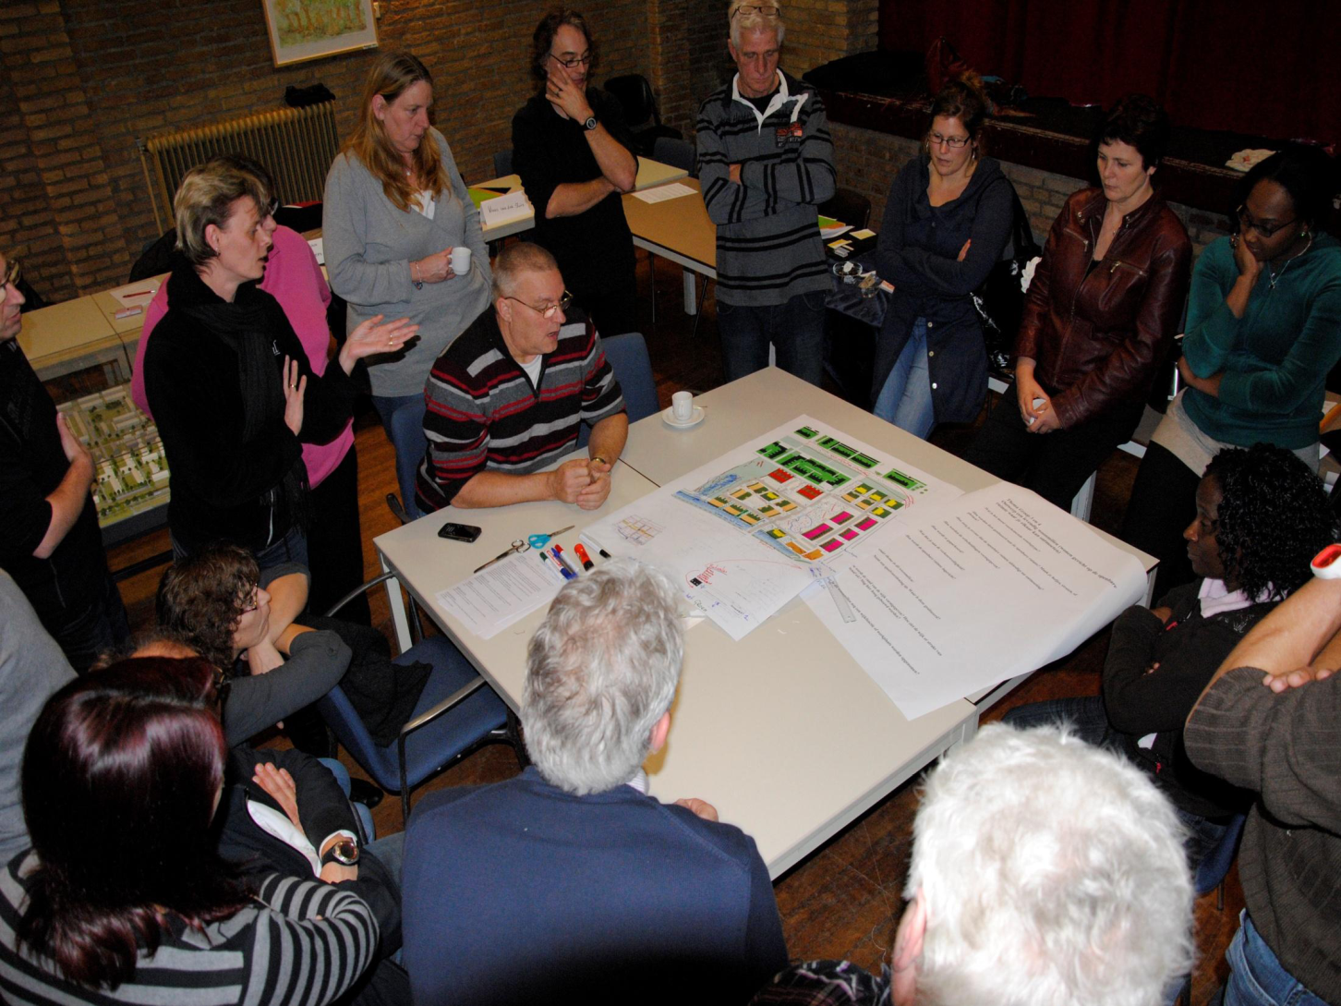
PEOPLE (2)

Slide 29
PARTICIPATION (1)
5. Decisionmaking
4. Coproducing
3. Advising
2. Consulting
1. Informing

Slide 30
PARTICIPATION (2)
Area developers of municipalities
Policy on active citizenship
Informing & consulting inhabitants
Ambition on coproduction
Area developers at housing associations:
Prescribed by law tenants organization
Informing, consulting & advising tenants
Ambition on coproduction
Notes:
→ What competencies are needed?

Slide 31
MEANING OF PLACE (2)
“Professionals should facilitate the attachment to place of living. Consequently people want to invest time, energy (and money) and work together to make (their) place better”

Slide 32
PROFILE A.D. 3.0?

Slide 33
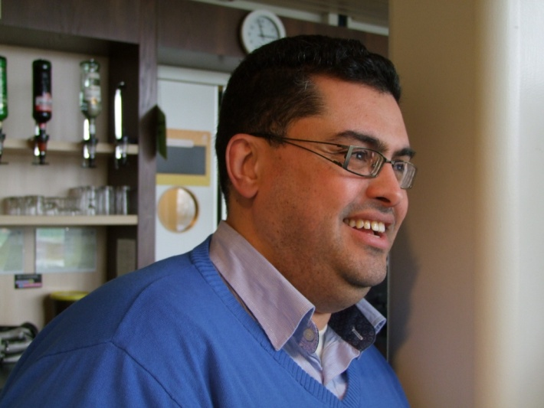
COMPETENCIES
General competencies
Project management
Proces management
Personal competencies

Slide 34
BASICS
Higher or academic educational level
Inspiring leadership
Effective communication
Making integral vision on area, neighbourhood, village, etc.
Making people & organisations work together
Empathy & reliability

Slide 35
HANZE EDUCATION
No specific educational program on area development
Technical, real estate, civil engineering, building, social work, governance, economics, education, etc.
Placements and training in the field important

Slide 36
EDUCATIONAL PROGRAMS
Project Area Development
Real Estate
Social Work
Architecture, Built Environment & Civil Engineering
Facility Management

Slide 37
PROJECT Area Development
Case study on (rural / urban) renewal
Real life project
Focus on social, economic, physical redevelopment
Multidisciplinary team intervision
Analysis and intervention
Feedback and assesment of experts

Slide 38
GIVE AWAY….
Communication is not the key word for area development, it is all about participation
Area development 3.0 is not an academic subject, but an attitude to better the world

Slide 39
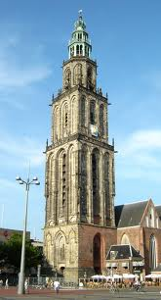
Thank you!
j.rozema@pl.hanze.nl
Hanzehogeschool Groningen

