Slide 1
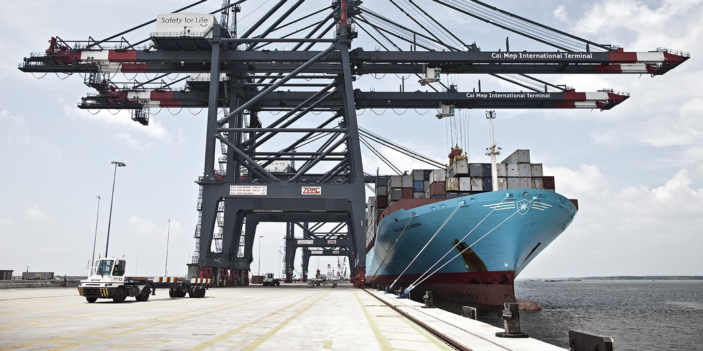
Presentation for Bremen Schifffahrtskongress
Creating Global Opportunities
March 18 2015, Chris Jephson

Slide 2
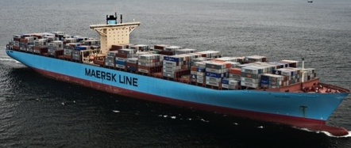
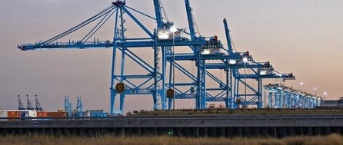
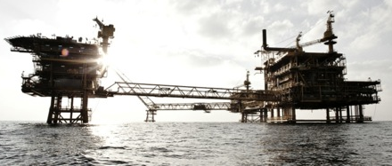
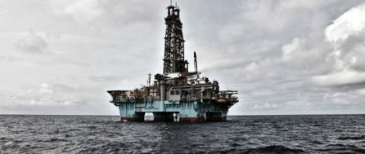
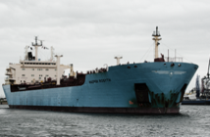
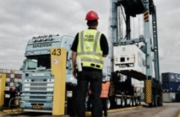
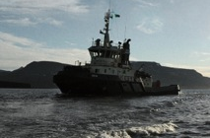
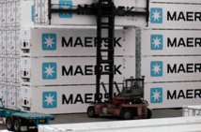
A. P. Moller - Maersk Group
Operates mainly in the shipping and energy industries
2014 Facts
89,000 employees
135 countries
$47b revenue
$4.5b profit
Maersk Line
APM Terminals
Maersk Oil
Maersk Drilling
Maersk Supply Service
Maersk Tankers
Damco
Svitzer
Maersk Container Industry

Slide 3
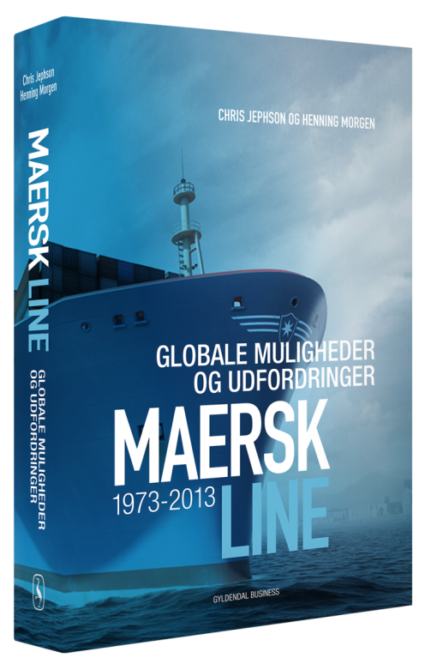
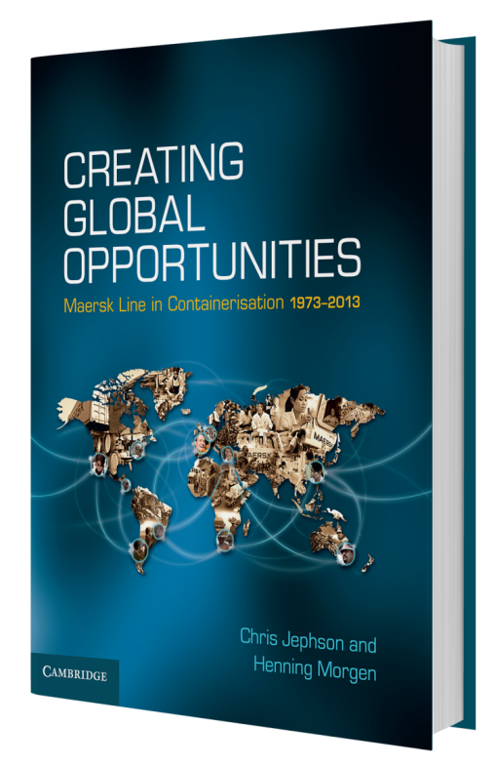
Chris Jephson
Born UK, 1947
Indonesia 1950-1955
Educated UK & USA
BSc in Politics, Economics &
Philosophy
Taiwan 1970
Maersk Line Copenhagen 1976
Maersk Line UK 1982
Maersk Logistics 1990
USA 1991-1992
Maersk Line Copenhagen 2005
Author 2013-14

Slide 4
”Creating Global Opportunities” Book Model
The
Maersk Line History
Facilitating
Global
Trade
The Container Shipping Industry
The Political and Economic Landscape

Slide 5
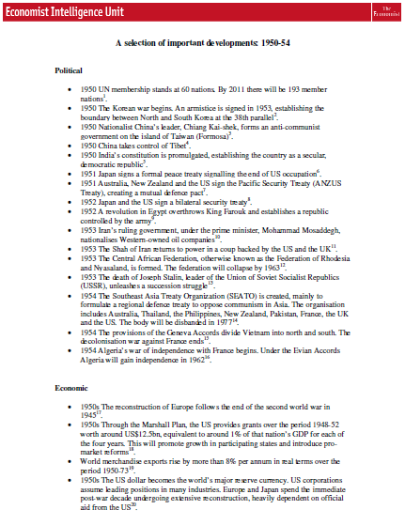
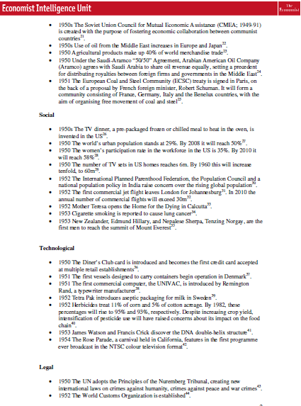
Elements in the Book – PESTLE Analyses

Slide 6
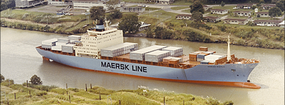
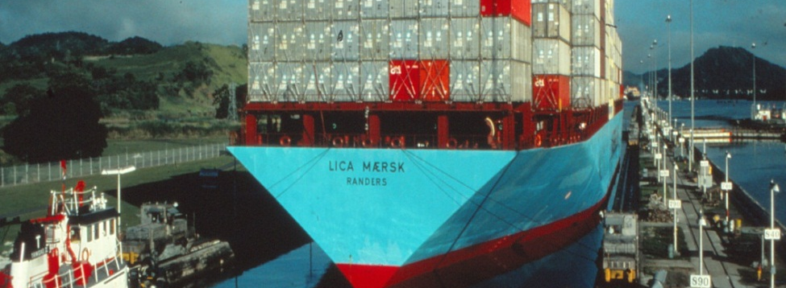
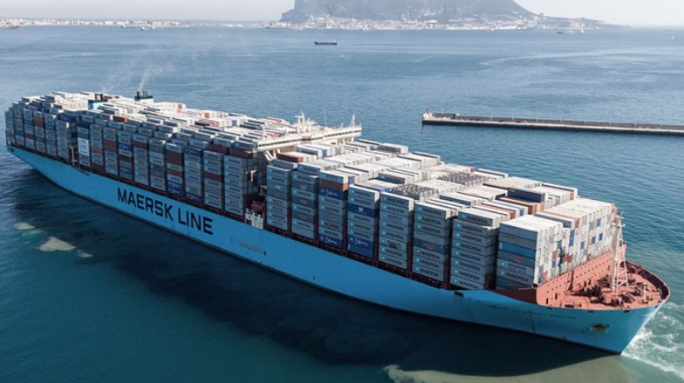
Vessel Development
1975: 1,600 TEU
1981: 3,500 TEU
1989: 4,300 TEU Panmax
1996: 6,000+ TEU
Post-Panmax
1997: 6,600+ TEU
Post-Panmax
2006: 15,000+ TEU
2013: 18.000 TEU

Slide 7
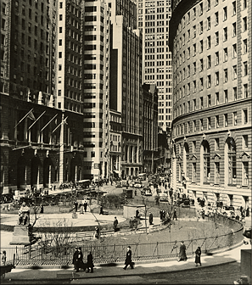
Organisation
Agents
  Own Maersk Line offices:
    1943: USA
    1947: USA, Japan
    1960: United Kingdom,
    Thailand, Hong Kong, Indonesia
    1975: Taiwan, Canada,
    Malaysia, Singapore
    1990: 40 offices
    2000: 100 offices
    2013: 350+ offices
    in 130+ countries

Slide 8
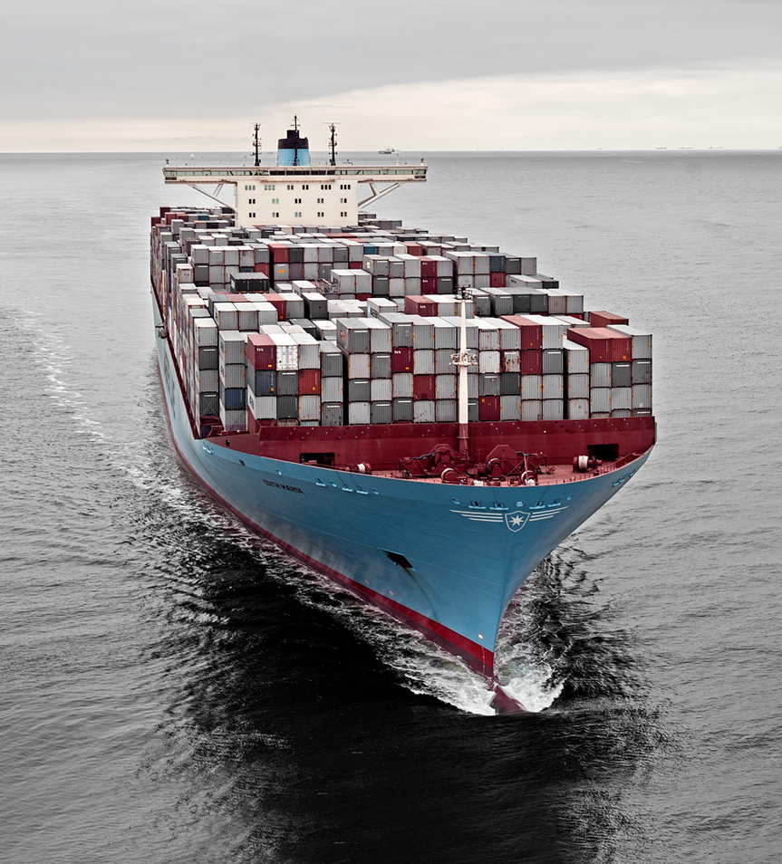
Maersk Line Today…..
Operates about 600 vessels globally
of which about 275 are owned
Staff of about 25,000 land-based
and 7,000 sea-based
Moved about 11 million full containers
In addition to the Maersk Line brand, operates the following regional
container brands:
  Safmarine
  MCC Transport
  Seago Line
  Mercosul
  Sealand
As from 1st January 2015, also in partnership with MSC on a series
of East-West trades
Notes:
Image and statement text on coloured background

Slide 9

Worlds’ Top 10 Container Ports 1970-2010
1970
Port name | Country | Total TEU
Oakland | USA | 336.364
Rotterdam | Netherlands | 242.328
Seattle | USA | 223.740
Antwerp | Belgium | 215.256
Belfast | UK | 210.000
Bremerhaven | Germany | 194.812
Los Angeles | USA | 165.000
Melbourne | Australia | 158.127
Tilbury | UK | 155.082
Larne | UK | 147.309
Top 30 Ports Globally |  | 3.777.602
1980
Port name | Country | Total TEU
New York/N.J. | USA | 1.947.000
Rotterdam | Netherlands | 1.900.707
Hong Kong | China (SAR) | 1.464.961
Kaohsiung | Taiwan | 979.015
Singapore (PSA) | Singapore | 916.989
Hamburg | Germany | 783.323
Oakland | USA | 782.175
Seattle | USA | 781.563
Kobe | Japan | 727.313
Antwerp | Belgium | 724.247
Top 30 Ports Globally |  | 21.115.695

Slide 10
Worlds’ Top 10 Container Ports 1970-2010
1970
Port name | Country | Total TEU
Oakland | USA | 336.364
Rotterdam | Netherlands | 242.328
Seattle | USA | 223.740
Antwerp | Belgium | 215.256
Belfast | UK | 210.000
Bremerhaven | Germany | 194.812
Los Angeles | USA | 165.000
Melbourne | Australia | 158.127
Tilbury | UK | 155.082
Larne | UK | 147.309
Top 30 Ports Globally |  | 3.777.602
1990
Port name | Country | Total TEU
Singapore (PSA) | Singapore | 5.223.500
Hong Kong | China (SAR) | 5.100.637
Rotterdam | Netherlands | 3.666.666
Kaohsiung | Taiwan | 3.494.631
Kobe | Japan | 2.595.940
Busan | Korea | 2.348.475
Los Angeles | USA | 2.116.410
Hamburg | Germany | 1.968.986
New York/N.J. | USA | 1.871.859
Keelung | Taiwan | 1.828.143
Top 30 Ports Globally |  | 52.417.493

Slide 11
Worlds’ Top 10 Container Ports 1970-2010
1970
Port name | Country | Total TEU
Oakland | USA | 336.364
Rotterdam | Netherlands | 242.328
Seattle | USA | 223.740
Antwerp | Belgium | 215.256
Belfast | UK | 210.000
Bremerhaven | Germany | 194.812
Los Angeles | USA | 165.000
Melbourne | Australia | 158.127
Tilbury | UK | 155.082
Larne | UK | 147.309
Top 30 Ports Globally |  | 3.777.602
2000
Port name | Country | Total TEU
Hong Kong | China (SAR) | 18.098.000
Singapore | Singapore | 17.086.900
Busan | Korea | 7.540.387
Kaohsiung | Taiwan | 7.425.832
Rotterdam | Netherlands | 6.280.000
Shanghai | China | 5.613.000
Los Angeles | USA | 4.879.429
Long Beach | USA | 4.600.787
Hamburg | Germany | 4.248.247
Antwerp | Belgium | 4.082.334
Top 30 Ports Globally |  | 129.582.641

Slide 12
Worlds’ Top 10 Container Ports 1970-2010
1970
Port name | Country | Total TEU
Oakland | USA | 336.364
Rotterdam | Netherlands | 242.328
Seattle | USA | 223.740
Antwerp | Belgium | 215.256
Belfast | UK | 210.000
Bremerhaven | Germany | 194.812
Los Angeles | USA | 165.000
Melbourne | Australia | 158.127
Tilbury | UK | 155.082
Larne | UK | 147.309
Top 30 Ports Globally |  | 3.777.602
2010
Port name | Country | Total TEU
Shanghai | China | 29.069.000
Singapore | Singapore | 28.431.000
Hong Kong | China (SAR) | 23.699.000
Shenzhen | China | 22.510.000
Busan | Korea | 14.194.000
Ningbo | China | 13.144.000
Guangzhou | China | 12.560.000
Qingdao | China | 12.012.000
Dubai | UAE | 11.600.000
Rotterdam | Netherlands | 11.145.000
Top 30 Ports Globally |  | 299.495.000

Slide 13
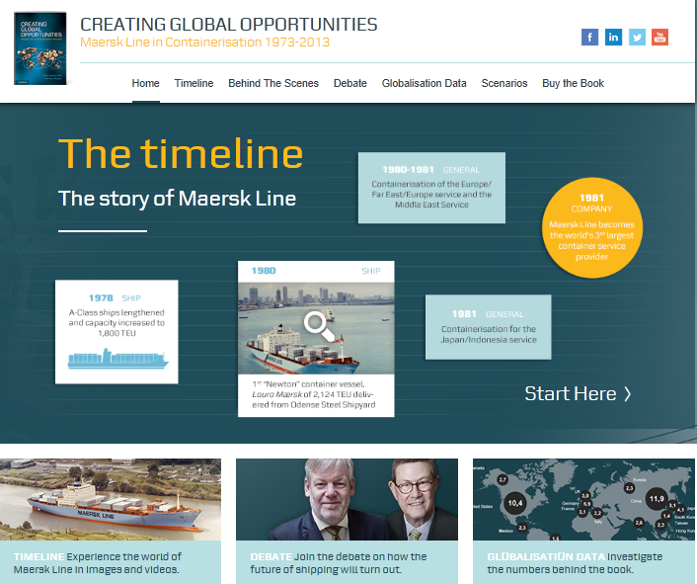
www.creatingglobalopportunities.com
Notes:
Two columns bullet text

Slide 14
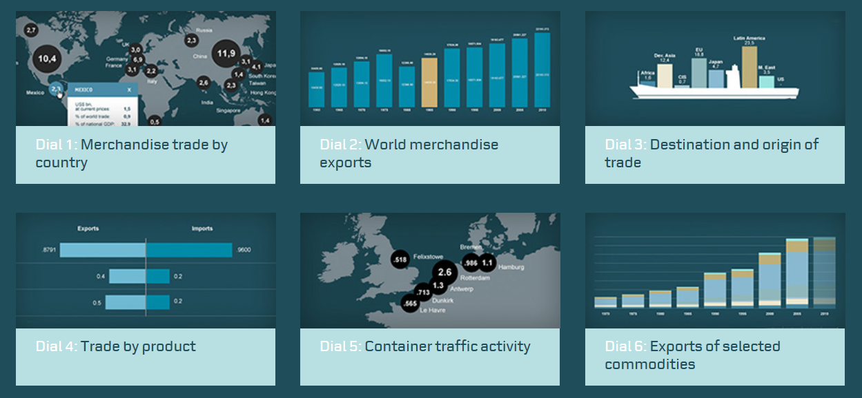
An Overview of the Historical Content
www.creatingglobalopportunities.com

Slide 15
Some comments on past and possible future economic developments

Slide 16
Trade grew at about 3.5% a year over the period.
In 1950, the United States represented 19.4% of global trade,
the United Kingdom 13.1%, Canada 6.3%, France 5.5%, Germany 4.6%
and Japan only 1.7% (just marginally more than Denmark’s 1.5%)
By 1955, Germany’s share had grown to 6.9% and Japan’s to 2.5%
but Western economies dominated international trade

Slide 17
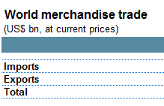



By 1970 world trade had grown to USD Billion 581.7
The United States still dominated with 14.8% of global trade. Germany had recovered with 11.0%, France had grown to 6.4%, Japan had expanded to 6.5% while the UK had dropped to 7.1%,
The ”Asian Tigers” of Hong Kong, Singapore and South Korea were just beginning their ”leap” with a total of 2.1% share of world trade

Slide 18


From 1970 to 1990, global trade grew by an average of 5.9% a year in USDollar terms, between 10% and 15% a year in volume
China appears in the data by 1980 with a 1.0% share that by 1990
had only climbed to 1.7%
The ”Asian Tigers” of Hong Kong, Singapore and South Korea had now been joined by Taiwan and collectively climbed to 7.9%
Japan’s share peaked around 1985 at 8.0% and already by 1990 had dropped to 7.6%, but overall, Asia’s share was now achieving 19.0% of world trade, doubling since 1950 (8.2%)

Slide 19
World merchandise trade
(USD bn, at current prices)
 |  |  | 1950 | 1970 | 1990 | 2010
Imports |  |  | 52,1 | 299,7 | 3.517,4 | 15.370,0
Exports |  |  | 47,6 | 282,0 | 3.383,2 | 14.938,3
Total |  |  | 99,7 | 581,7 | 6.900,6 | 30.308,3
World Population |  |  | 2,5B | 3,7B | 5,3B | 6,9B
By 2010, U.S. is the only country with a double-digit share at 10.7%
Germany was at 7.4% and Europe (DE, FR, IT, UK) at 17.2%
China was well on its way to overtake the U.S. at 7.8% and the main Asian
economies were at 24.2%
The financial crisis of 2008 – 2009
It took until 2011 for global trade to again exceed the level of 2008
The ”multiplier” (GDP growth to cargo volume) appears to have largely
disappeared sine 2008

Slide 20
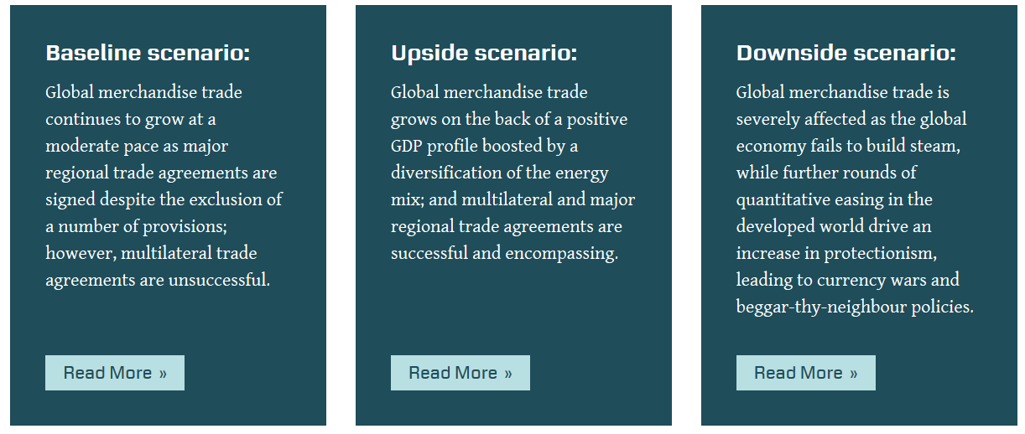
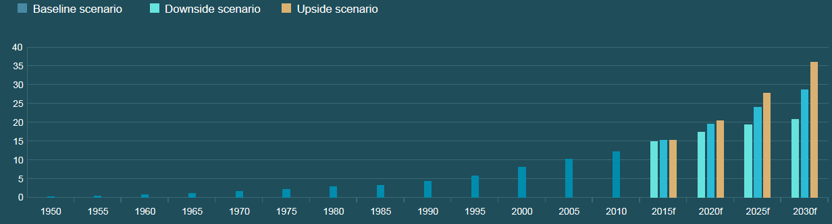
The Forward-Looking Opportunities
www.creatingglobalopportunities.com

Slide 21
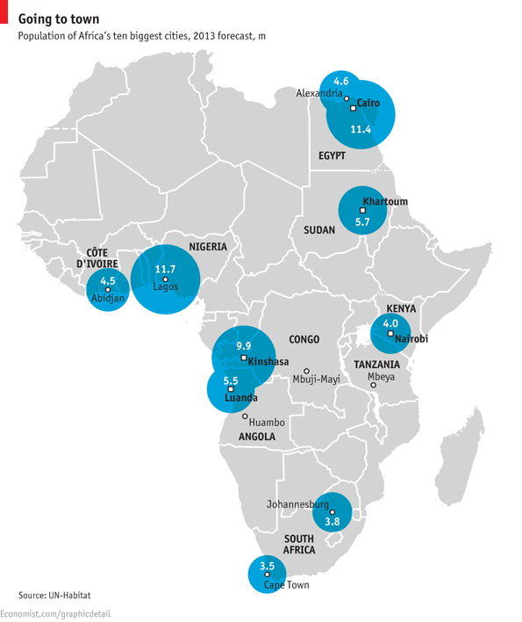
Africa is emerging but has a long way to go
The African population will increase by 30%
(or 330m people) from 2013 to 2025, taking the population to 1.4bn (or 18% of the global total).
Urbanisation and income growth will ensure the continued emergence of top tier and second tier cities over the coming decade.
These changes will boost demand for basic and higher value consumer goods and associated distribution and retail networks.
Population of Africa’s ten biggest cities in 2013 (m)
+ 330m by 2025
CAGR of 2.2% from 2013-2025
Sources: UN, US Census Bureau; IMF. Compiled by The Economist Intelligence Unit 10/2014

Slide 22
Some more on Africa……..
China is by far Africa’s largest trading partner at USD 160 billion a year
1 million Chinese work in Africa
But, India’s trade with Africa, at USD 100 billion, is growing faster than China’s
Foreign Direct Investment into Africa shows a different picture (2014):
  UK USD 7.5 billion
  US USD 3.7 billion
  Italy USD 3.6 billion
  China USD 2.5 billion
  France USD 2.1 billion
  India USD 1.8 billion
The Economist 17/1/15

Slide 23
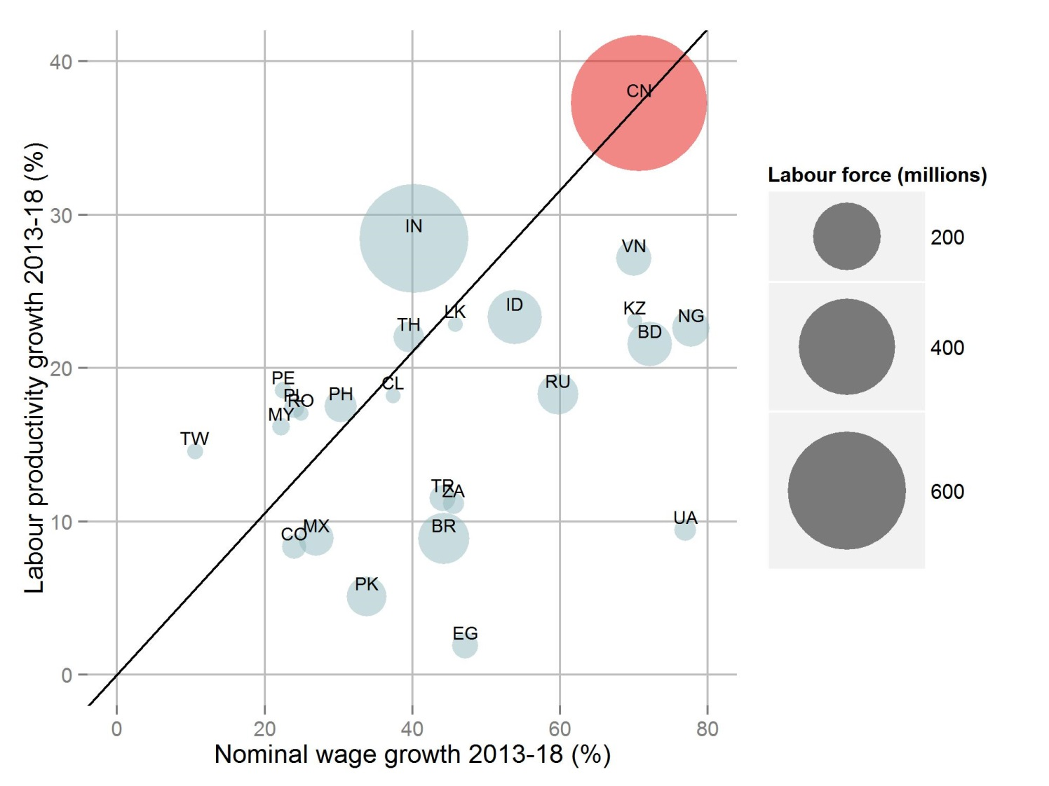
China is far from becoming uncompetitive
India, Philippines,
Peru, Poland and Taiwan are among those becoming more attractive compared
to China
Bangladesh, Vietnam, Nigeria, Russia and Brazil are becoming less attractive
Economist Intelligence Unit 10/2014

Slide 24
A few thoughts on China’s development
China today exports more in 6.5 hours than it did in the whole of 1985
Source: Economist 11/10/14 from World Bank data
China produced USD 9.5 Trillion worth of goods and services in 2013. Three times more than in 2007
Source: Economist 11/10/14 from World Bank data
China is a capital exporting country and it is now poised to become
a net exporter of capital.”
Deputy Minister of Commerce, Zhang Xiangchen, Financial Times, 10/2014
China since 1977 has managed to engineer the longest growth period ”in the history of mankind.” The only countries that come close are Taiwan and South Korea which managed 32 and 29 years respectively.
Financial Times 20/11/14

Slide 25
A few more thoughts on China’s development
88,000 firms from Taiwan operate in China, employing 15.6 million workers while 23,000 Japanese firms employ about 11 million and South Korean firms employ about 2 million workers
In 2010, China committed more loans to Latin America than the World Bank, Inter-American Development Bank and the US Export-Import Bank combined.
Today, China is the largest trading partner of Brazil, Chile & Peru
Source: The Economist 8/11/14
President Xi: Trade with Latin America to be doubled by 2019
2000: USD 10 billion 2013: USD 257 billion
The Economist 17/1/15
China is ”profoundly affected by the awareness that China has not participated in making the rules of the system”
Henry Kissinger ”World Order”

Slide 26
Some thoughts on Asia as a whole…………
54% of Asia’s trade is within the region, up from 25% in 1990
Asia represents 27% of world market capitalisation, up from 20% ten years ago.
Since 2000, Asia has created over 11,000 IPO’s, now has over 25,000 listed companies while China has 41 million private businesses.
18% of the world’s trade is now settled in Ren Min Bi, the world’s
7th most used currency.
29% of global R&D occurred in Asia in 2012.
30% of the world’s middle class spending is done by Asians.
41% of the world’s patents filed in 2012 were in Asia.
47% of the world’s manufacturing takes place in Asia.
The Economist 31st May 2014

Slide 27
A Current Opportunity: Trade Negotiations in Asia
 | Trans Pacific Partnership (TTP)
 |  |  |  |  |  |  |  | Australia
 |  | Canada |  |  |  |  |  | Brunei
 |  | Chile |  |  |  |  |  | Japan
 |  | Mexico |  |  |  |  |  | Malaysia
 |  | United States |  |  |  |  |  | New Zealand |  |  |  |  | Cambodia
 |  | Peru |  |  |  |  |  | Singapore |  |  |  |  | India
 |  |  |  |  |  |  |  | Vietnam |  |  |  |  | Laos
 |  |  |  |  |  |  |  |  |  |  |  |  | Myanmar
 |  |  |  |  |  |  |  | China
 |  | Hong Kong |  |  |  |  |  | Indonesia
 |  | Papua New Guinea |  |  |  |  |  | Philippines
 |  | Russia |  |  |  |  |  | South Korea
 |  | Taiwan |  |  |  |  |  | Thailand
 |  |  |  |  |  |  | Regional Comprehensive Economic
 |  |  |  |  |  |  | Partnership (RCEP)
Free Trade Area of the Asia Pacific (FTAAP-21)
TPP: A US initiative, excluding China
RCEP: Promoted by ASEAN
FTAAP-21: promoted by China at Beijing APEC summit 11/14. Comprehensive, 50 year old idea.
Source: The Economist 8/11/14

Slide 28
Thank You!
www.creatingglobalopportunities.com

