Slide 1
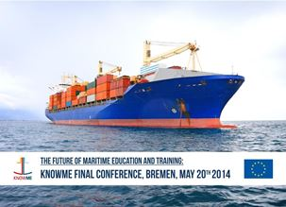
THE FUTURE OF MARITIME EDUCATION AND TRAINING
KNOWME Final Conference
8. Bremer Schifffahrtskongress 2014
Jesus Carbajosa, Research and Innovation Department
International Center of Numerical Methods Applied in Engineering, CIMNE – Spain
carbajosa@cimne.upc.edu

Slide 2
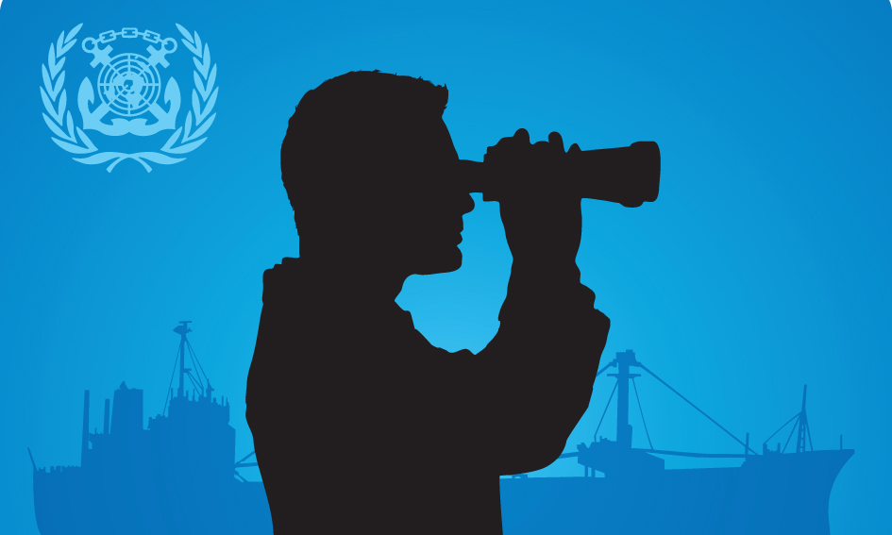
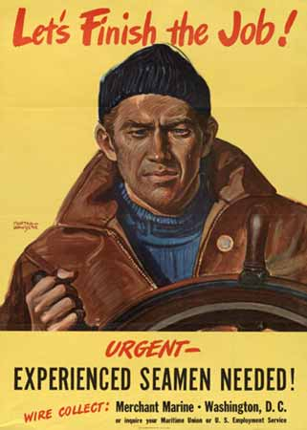
¡ Experienced Seamen Needed !
The Work at Sea: A concurrent situation (1)
“The issue for the majority of seafarers is not whether to leave the sea but when” was an observation made by Frank Main, then head of Maritime Department at Liverpool Polytechnic, in the mid-1970s. The retention of seafarers on board is a problem that has existed for more than 30 years.
“Those who could (go to sea), won’t” (and “those who would (go to sea), can’t”) were conclusions from the METHAR (Harmonisation of European MET Schemes) project in 1999, which identified a serious decline of interest of young people in seafaring and an insufficient supply of ship officers from EU countries (and a shortage of shipboard training places).

Slide 3
¡ Experienced Seamen Needed !
The Work at Sea: A concurrent situation (2)
2006: “Employment in the shipping sector is affected by many different factors. One of the most significant factors affecting employment in this sector in the EU in the upcoming years is the ageing profile of the EU national workforce, and at the same time the poor image of the sector resulting in low numbers of young people taking up education or training in this field and low attractiveness caused by long absences away from home. Indeed, these factors present a real threat for the European shipping industry.”
Source: An exhaustive analysis of employment trends in all sectors related to sea or using sea resources / Final report for the European Commission, DG Fisheries and Maritime Affairs C3135 / September 2006

Slide 4
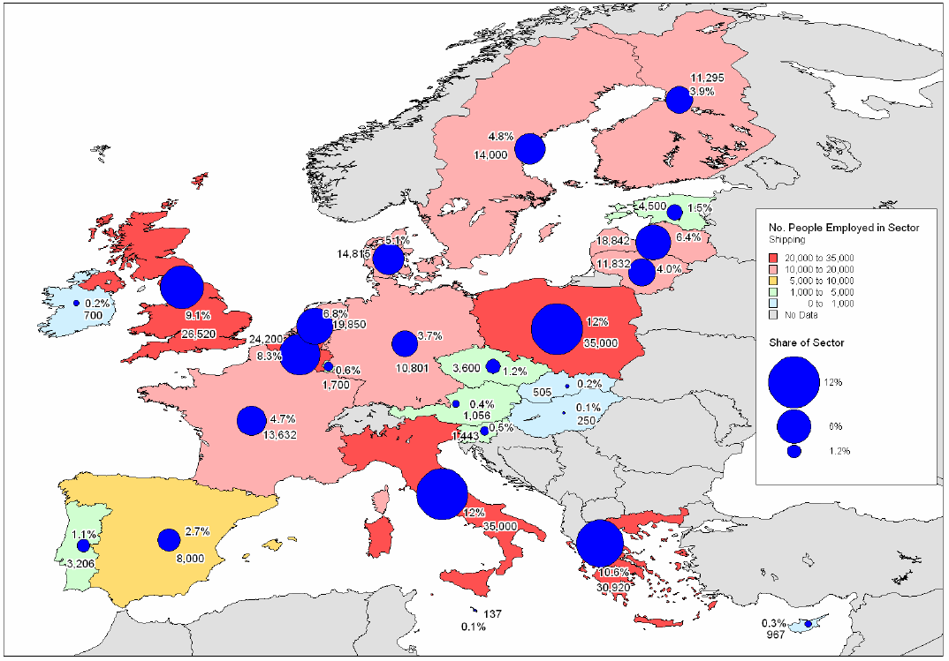
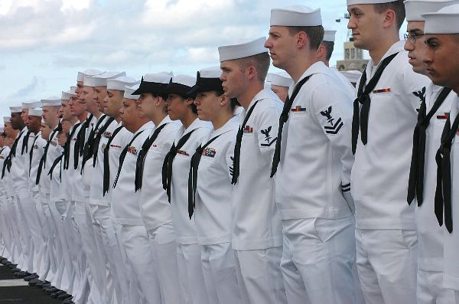
Since late 1990’s, General employment trends showed a picture of decline in employment
Source: An exhaustive analysis of employment trends in all sectors related to sea or using sea resources / Final report for the European Commission, DG Fisheries and Maritime Affairs C3135 / September 2006 / Source: ECOTEC Research and Consulting, 2006

Slide 5
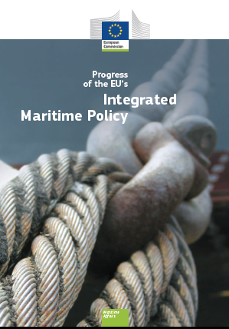
Progress of the EU’s Integrated Maritime Policy 2012*
“Many maritime industries are lacking people with the right qualifications, skills and experience. Actions have been launched to build attractive maritime careers based on mobility between sectors and countries, and anticipation of future needs.
Following adoption of the Maritime Transport Strategy 2018, a Task force on Maritime, Employment and Competitiveness delivered recommendations in June 2011, including completing the review of the exclusion of seagoing workers from the scope of EU labour law, updating the Directive on the training of seafarers, and ensuring implementation of the ILO Maritime Labour Convention”.
* Report from the Commission to the European Parliament, the Council, the European Economic and Social Committee and the Committee of the Regions, COM(2012) 491 final European Commission Directorate Directorate-General for Maritime Affairs and Fisheries

Slide 6
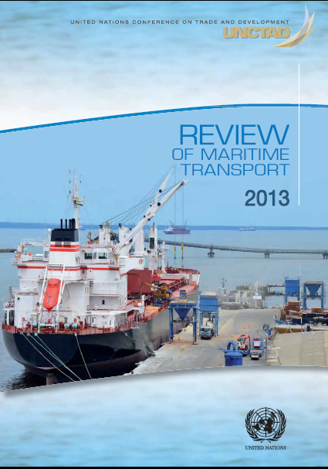
2014
According to the Review of Maritime Transport 2013, the 2006 Maritime Labour Convention is still the in force agreement to meet the employment conditions required in Maritime Transport, it considers the following aspects:
minimum requirements for seafarers to work on a ship;
conditions of employment;
accommodation, recreational facilities, food and catering;
health protection, medical care, welfare and social security protection; and
compliance and enforcement.
These five titles are really far to attract young people to work at se
Review of Maritime Transport 2013; UNITED NATIONS CONFERENCE ON TRADE AND DEVELOPMENT; UNCTAD

Slide 7
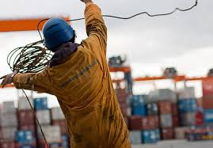
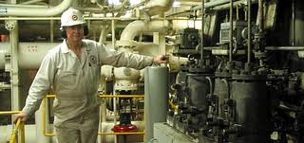
¡Working at Sea!
From different studies, several important factors emerge that may affect career prospects and choices for young Europeans to select maritime careers:
Publicity:
Publicity for seafaring maritime careers is poor and unbalanced. It is adversely affected by several factors including family experiences during a prolonged shipping recession, and media reports of disasters with very little positive coverage of the importance of seafaring trade.
The remoteness of seafaring activities from everyday life makes it very difficult to understand the work involved and to compare it objectively with other career choices

Slide 8
¡Working at Sea!
Recruitment and selection:
The selection process carried out by industry is aimed at meeting the ship operators needs for seafarers but largely ignores the longer term requirements for seafaring expertise in management and other shore based posts.
Colleges select on a broader range of criteria but do not give a clear professional and industrial career focus to their programmes and offer very little practical training

Slide 9
¡Working at Sea!
Maritime education and training ashore:
European basic education has better teachers and better access to modern equipment, such as computers, than most competing developing countries;
European maritime colleges at present have some capacity to increase numbers for traditional education and training of seafarers, but are getting out of date and capacity is being reduced by financial pressures;
European maritime education and training should be focused in the longer term on the manning of new generation high technology ships as well manning existing more traditional fleets;
To meet the training needs for modern ships, European maritime colleges will need better resources, more modern facilities and improved staffing and staff development; and
Some trainees from developing countries find, through lack of basic education and/or languages problems, that theoretical concepts of professional studies are difficult to understand;

Slide 10
¡Working at Sea!
Maritime education and training at sea:
There are a limited number of sea training places in European flag vessels, and there is a very limited budget for company training of all their seafarers from both Europe and from developing countries;
Many companies do not provide sea training places, the reasons may be unsuitable ships and trades but are more likely to be financial
European internal trades, which are increasingly important, tend to be operated by smaller ships, with small crews and fewer opportunities for training; and
Seafarers from the developing world are normally cheaper to train as well as being cheaper to employ, though there may be problems with basic education and with language/communications

Slide 11
¡Working at Sea!
Immediate career prospects:
Juniors require sea service to continue their training to higher levels. They are able to compete for many posts in European internal shipping, and international shipping under the flags of European Union member states.
Juniors sometimes find it difficult to compete on economic grounds for posts on European ships and even the open/flags of convenience registries, partly because places are “blocked” by long service personnel from developing countries.
In some cases, where there are defence implications for shipping services, there may be support for the employment of nationals by the Member States Government concerned.

Slide 12
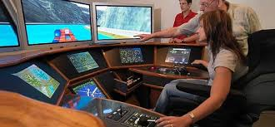
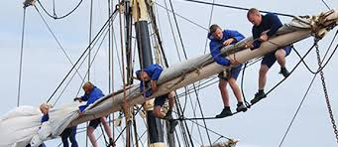
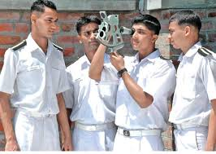
¡Maritime Education and Training, MET!
Education and training for the European maritime infrastructure:
Virtually no resources are allocated to training of seafarers for second careers in the European maritime infrastructure, surveyors, pilots, harbour masters, ship repairers, maritime teachers, administrators or any of the other posts normally filled by former seafarers; and
Maritime related college courses provide an academic base, but without seafaring experience the graduates lack the essential practical knowledge required for many of maritime shore based “second” careers.

Slide 13
¡Maritime Education and Training, MET!
Longer term career prospects:
Seniors will have the choice of a wide range of possible jobs in the European maritime infrastructure as the older generation retire; and
The choice of careers and rapid promotion for qualified and experienced Europeans will be brought about partly by a shortage of trained manpower and partly by the inability or reluctance of some experienced senior staff from developing countries to move to Europe to further their careers.

Slide 14
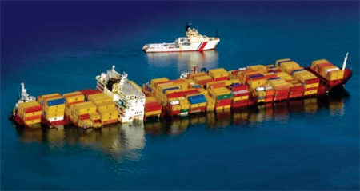
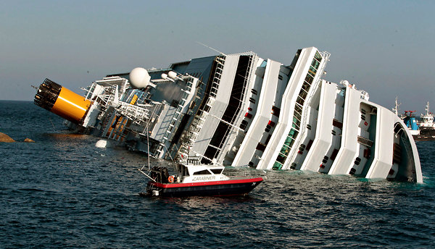
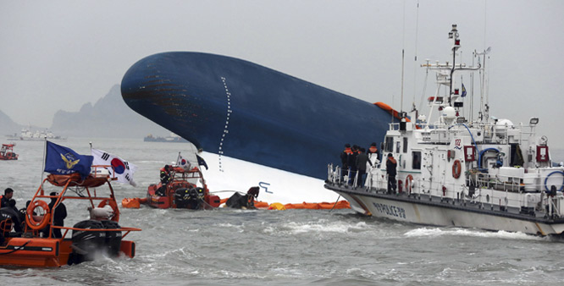
¡ Something Goes Wrong!
The working and living conditions of seafarers that must be inspected and approved by the flag State before certifying a ship are as follows:
Minimum age;
Medical certification;
Qualifications of seafarers;
Seafarers’ employment agreements;
Use of any licensed or certified or regulated private recruitment and placement service;
Hours of work or rest;
Manning levels for the ship;
Accommodation;
On-board recreational facilities;
Food and catering;
Health and safety, and accident prevention;
On-board medical care;
On-board complaint procedures;
Payment of wages
Review of Maritime Transport 2013; UNITED NATIONS CONFERENCE ON TRADE AND DEVELOPMENT; UNCTAD

Slide 15
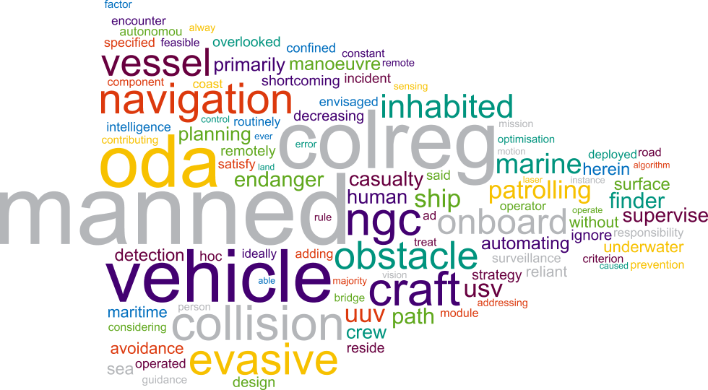
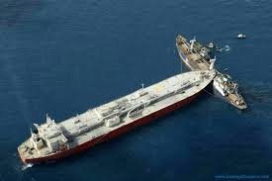
¡ Something Goes Wrong!
During COLREGS project Workshop, held at Warsash Maritime Academy in South Hampton, Hampshire on April 2014, after a survey made, no more than 30% of the seafarers asked, gave the same solution to a Risk Navigation Situation proposed. Something goes wrong with MET

Slide 16
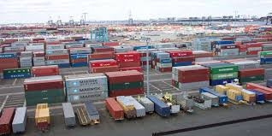
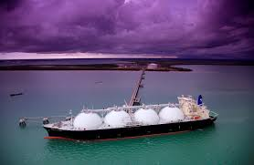
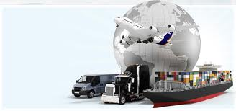
¿What’s next?
Work at Land*
Port development and Logistics are seen as catalyst to stimulate economic activity and create employment. Virtually every government, national, regional or local authority, as well as the ports themselves, have a port development plan with the aim of increasing the wealth of its citizens through the provision of some service. Commercial and shipping is increasing, and leisure ships is a growing market. However, these have been reduced more in 2013 and 2014 as they are also areas that have been the most affected by the economic downturn. The biggest increases and skills shortages are going to be in naval and defence and renewables. Other challenges include the rise of rival industries, such as nuclear, construction and oil and gas, which are offering good rates of pay and attracting people back. We are losing a lot of people who are trained for the marine sector to other industries.
* All aboard – marine recruitment trends for 2012, Natalie Desty, the department head of marine and shipping at Matchtech, one of the UK's leading technical recruitment agencies. http://www.ship-technology.com/features/featureall-aboard-marine-recruitment-trends-for-2012/

Slide 17
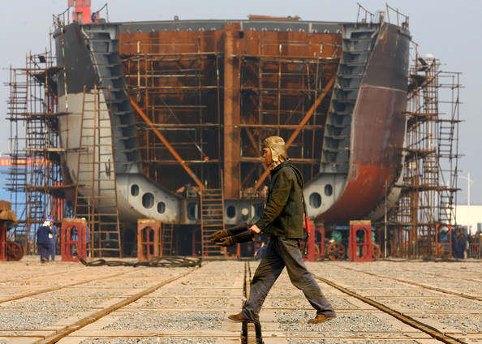
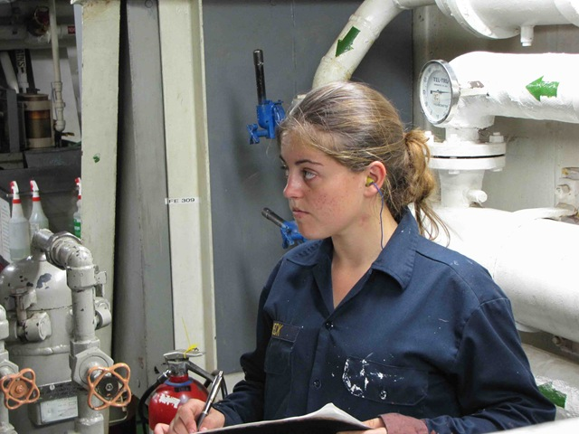
¿What’s next?
Some Solutions Suggested*
Industry image campaigns will not solve officer shortages and should not be seen as a potential solution to the recruitment problem. Industry image campaigns should encompass the improvement of working and living conditions at sea with a view to make the seafarers’ career more attractive and to increase the length of duty at sea.
National governments and other actors should orient their maritime education systems, tax policies, and cluster promotion policies to enhance the flow of seafaring labour to shore-side industries.
Employers and maritime education and training institutions should make all possible efforts to promote equality for women in seafaring careers. However, recruiting and training more women will not contribute to solving the officer shortage unless employers hire more EU-domiciled junior officers and ratings.
Tonnage tax regulations must require shipping firms to participate in national training schemes and to employ significant numbers of European junior officers and ratings. Shipping firms should only be eligible to benefit from tax advantages and other forms of state support if they demonstrate they are meeting these criteria.
It is recommended that a detailed specification of necessary data on seafarers’ employment should be developed. Appropriate agencies/organisations (e.g. EUROSTAT, EMSA, OSHA) should be instructed/commissioned to prepare, collect and publish these data, and this with a view to supporting policy developments.
* How to enhance training and recruitment in the shipping industry in Europe; Final Report: European Transport Workers’ Federation (ETF). Brussels 2011.

Slide 18
THANK YOU VERY MUCH

