Slide 1
6. Bremer Schifffahrtskongress 29.02 – 01.03 2012 Maritime Resource Management
Martin Hernqvist
Managing Director, The Swedish Club Academy AB
Maritime Resource Management

Slide 2
Theme of kongress: Employability management
Employability:
“A person’s capability for gaining and maintaining employment”
Maritime Resource Management

Slide 3
Theme of kongress: Employability management
A person’s employability assets are:
His/Her:
Knowledge
Skills
Attitudes
Maritime Resource Management

Slide 4
Theme of kongress: Employability management
I will focus on the employability asset Attitudes.
Because of its importance for safety and efficiency.
Because the industry historically has overlooked its importance and/or found it difficult to deal with.
But look upon it from what we can do – as training providers or employers.
Maritime Resource Management

Slide 5
Questions:
Why do we make mistakes?
Do we make mistakes and cause incidents intentionally?
Maritime Resource Management

Slide 6
“Cold and refreshing”

Slide 7
Cold and refreshing...
Mental picture
Reality
Maritime Resource Management
Notes:
The answer is that we do not make decisions based on reality. We make decisons based on our mental picture, or mental model, of reality. Sometimes, with tragic consequences, our mental picture and reality are far apart.

Slide 8
Answer:
People make mistakes when mental picture and reality differ
Maritime Resource Management

Slide 9
We also learn:
People don’t make mistakes deliberately.
But what can we do about it?
Maritime Resource Management

Slide 10
What can we do about it?
Understanding accidents better
Learn about our limitations
Focus on attitudes
Establish safe organizational cultures
This is what Maritime Resource Management (MRM) training is all about
Maritime Resource Management

Slide 11
Attitudes and behaviour
We need to change attitudes, not skills. What is an attitude? Why are attitudes important?
Attitude:
It is a way of thinking about
somebody or something.
Your behaviour towards
somebody or something depends
on your attitudes.
Maritime Resource Management

Slide 12
MRM in brief:
Assertiveness training
Maritime Resource Management

Slide 13
For increased safety in shipping, this is on one of the most important issues…
Maritime Resource Management

Slide 14
How can we deal with this problem
through training?
… The position at 10.27 hours (two minutes before the collision)
is on the port side off the course line on the chart. “I did not report this to the pilot”…
… He did not call the master despite standing orders and his concern about the situation …
Maritime Resource Management

Slide 15
Question:
Why do not people “challenge” mistakes and unsafe acts?
Maritime Resource Management

Slide 16
Seafarers attitudes to challenging
If a superior officer, or pilot, makes a mistake. Do you challenge?
No, it is not my job.
I might be wrong.
No, I might lose my job.
Never again. He hasn’t talked to me since last time.
(Challenge: To question whether something is true, right or valid.)
Maritime Resource Management

Slide 17
Challenge and Response
Maritime Resource Management

Slide 18
No Challenge, No Response
Maritime Resource Management

Slide 19
Desired attitudes after MRM training
If a superior officer, or pilot, makes a mistake. Do you challenge?
Yes, it is my duty.
Yes, people expect me to.
Yes, safety comes first. Those missing words; “But we still have one more buoy to go” may have disastrous consequences.
Maritime Resource Management

Slide 20
Back to the root of the problem:
Why do not people “challenge” mistakes and unsafe acts?
Has this to do with “culture”?
Maritime Resource Management

Slide 21
Question:
What is “culture”?
Maritime Resource Management

Slide 22
Power distance
Hofstede’s Power Distance Index measures the extent to which the less powerful members of organizations and institutions (like the family) accept and expect that power is distributed unequally.
Power distance reflects how decisions of the power holders should be viewed – challenged or accepted.
Maritime Resource Management

Slide 23
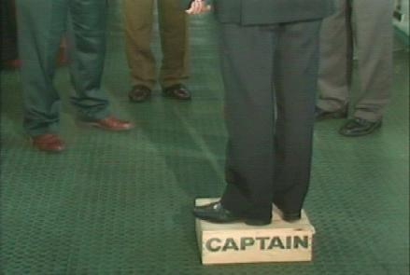
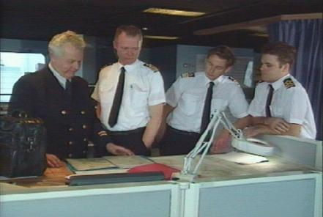
Power distance
High power distance ship
Low power distance ship
Maritime Resource Management

Slide 24
Power distance index
Philippines 94
Germany 35
Malaysia 104
Panama 95
China 80
Indonesia 78
India 77
Brazil 69
France 68
Hong Kong 68
Turkey 66
Belgium 65
Thailand 64
Portugal 63
Greece 60
South Korea 60
Iran 58
Taiwan 58
Spain 57
Japan 54
Hungary 46
Jamaica 45
United States 40
Netherlands 38
Australia 36
U. K. 35
Finland 33
Norway 31
Sweden 31
Ireland 28
Denmark 18
Austria 11
Maritime Resource Management

Slide 25
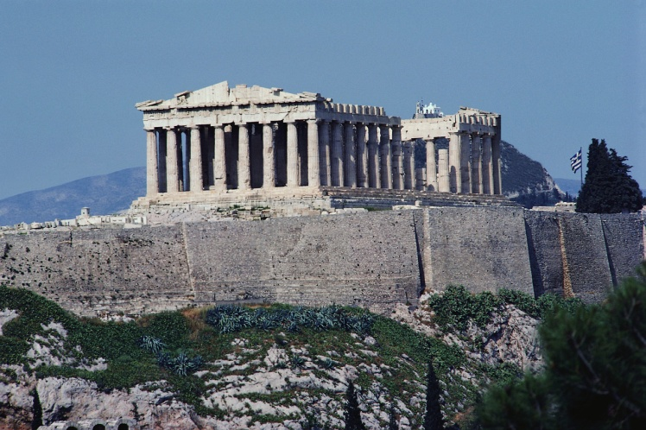
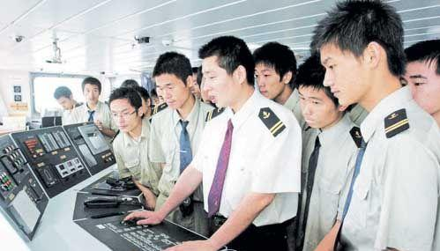
Cultures
National
Organizational
Professional
Maritime Resource Management

Slide 26
Culture, Attitudes and Behaviour
National
Attitudes
Behaviour
Professional
Organizational
Maritime Resource Management

Slide 27
So, we want to change attitudes – but what are the attitudes of seafarers?
Maritime Resource Management

Slide 28
Culture at Work in Aviation and Medicine
Maritime Resource Management

Slide 29
Professional culture, Aviation vs Medicine
A clear difference in attitudes
Major reason the impact of resource management training on pilots’ attitudes
Maritime Resource Management

Slide 30
“Even when fatigued I perform effectively during critical periods.”
Maritime Resource Management

Slide 31
Professional culture, Aviation vs Medicine
Maritime Resource Management

Slide 32
Mariner Attitude Survey
The survey contains 159 questions, most “tick-box”.
20-30 minutes to complete.
Free-text fields at the end – mariners’ views on what can further improve safety, efficiency and job satisfaction.
Divided into 11 sections:
A. TEAMWORK ON BOARD
B. PERSONAL ATTITUDES
C. LEADERSHIP STYLES
D. ORGANIZATIONAL ISSUES
E. WORK PRACTICES
F. WORK GOALS
G. AUTOMATION
H. MULTI-NATIONAL CREW
I. DEMOGRAPHICS
J. RESOURCE MANAGEMENT AND TEAM TRAINING
K. COMMENTS (OPTIONAL)
Maritime Resource Management

Slide 33
Summary
The employability asset Attitudes:
Is critical for safety and efficiency.
Often overlooked and/or not dealt with in shipping.
But training providers and employers have an efficient tool in form of resource management training.
Maritime Resource Management

